Slide 1

Abhinav Anil
PRN-18030142001
Subject – Big Data
Course – MSc.CA(DataScience)
College – Symbiosis Institute of Computer Studies and Research

Slide 2
Content
1: NOSQL Types
2: Motivation
3: MongoDB vs SQL
4: IDE to run mongoDB
5: Installation of mongoDB
6: Create Connection on Studio 3T for mongoDB
7: Create and Drop Database
8: Create and Drop Collection
9: Insert Documents
10 : Query Document
11: Use OR AND condition
12 : Update and Save Document
13: Delete Document
Sort, Skip and Limit

Slide 3
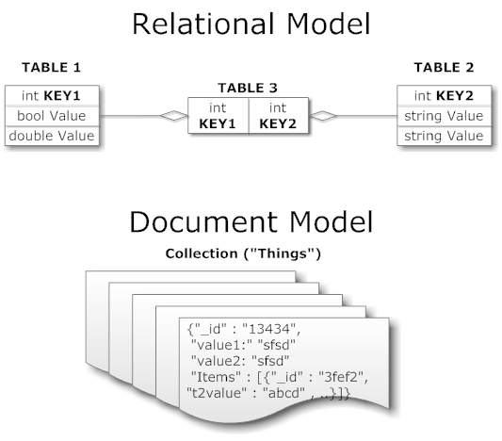
NoSQL Types
Key/value (Dynamo)
Columnar/tabular (HBase)
Document (mongoDB)

Slide 4
Motivations
Problems with SQL
Rigid schema
Not easily scalable (designed for 90’s technology or worse)
Requires unintuitive joins
Perks of mongoDB
Easy interface with common languages (Java, Javascript, PHP, etc.)
DB tech should run anywhere (VM’s, cloud, etc.)
Keeps essential features of RDBMS’s while learning from key-value noSQL systems
Notes:
Quotes from a person

Slide 5
mongoDB vs. SQL
mongoDB | SQL
Document | Tuple
Collection | Table/View
PK: _id Field | PK: Any Attribute(s)
Uniformity not Required | Uniform Relation Schema
Index | Index
Embedded Structure | Joins
Shard | Partition

Slide 6
RDBMS |  | MongoDB
Database | ➜ | Database
Table | ➜ | Collection
Row | ➜ | Document
Index | ➜ | Index
Join | ➜ | Embedded Document
Foreign Key | ➜ | Reference

Slide 7
IDE to run mongoDB
Command line
MongoDB Compass Community
Studio 3T for MongoDB

Slide 8
Installation of MongoDB
https://www.mongodb.com/download-center/community
From here we can get the mongoDB CLI as well as Compass Community.
https://studio3t.com/download/
From the above link we can download studio 3T for mongoDB IDE

Slide 9
Create Connection in studio 3T for mongoDB
Click on File -> Connect
Click on New Connection
Write connection name (like learn MongoDB)
Click on Test Connection -> Ok
Click on your connection name
Click on connect

Slide 10
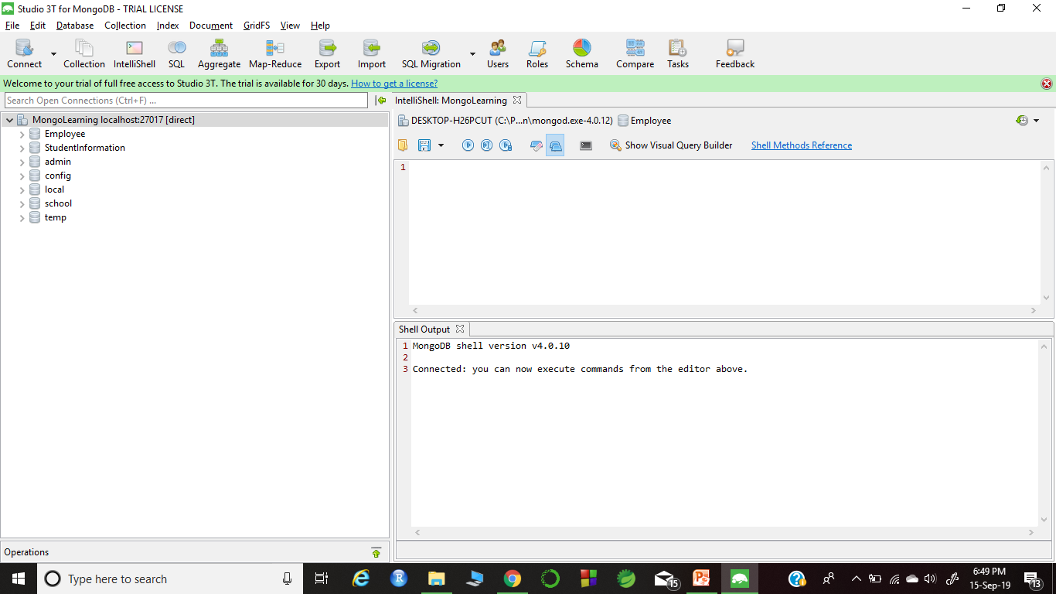
Continue…

Slide 11
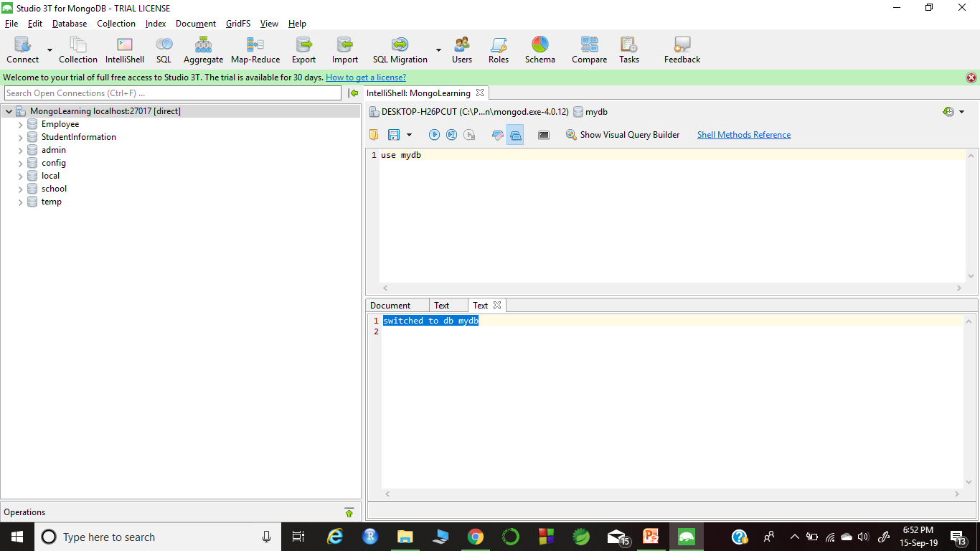
Create and Drop Database
For creating database
Syntax: use <database name>
Example: use mydb
Output : - switched to db mydb

Slide 12
Continue…
To see created the db we have to use command
show dbs
In mongoDB we have to at least insert one record to make our db visible.
So, I am going to use two command making my db visible
db.myCollection.insert({"name" : "Abhinav"})
output : WriteResult({ "nInserted" : 1 })
Show dbs

Slide 13
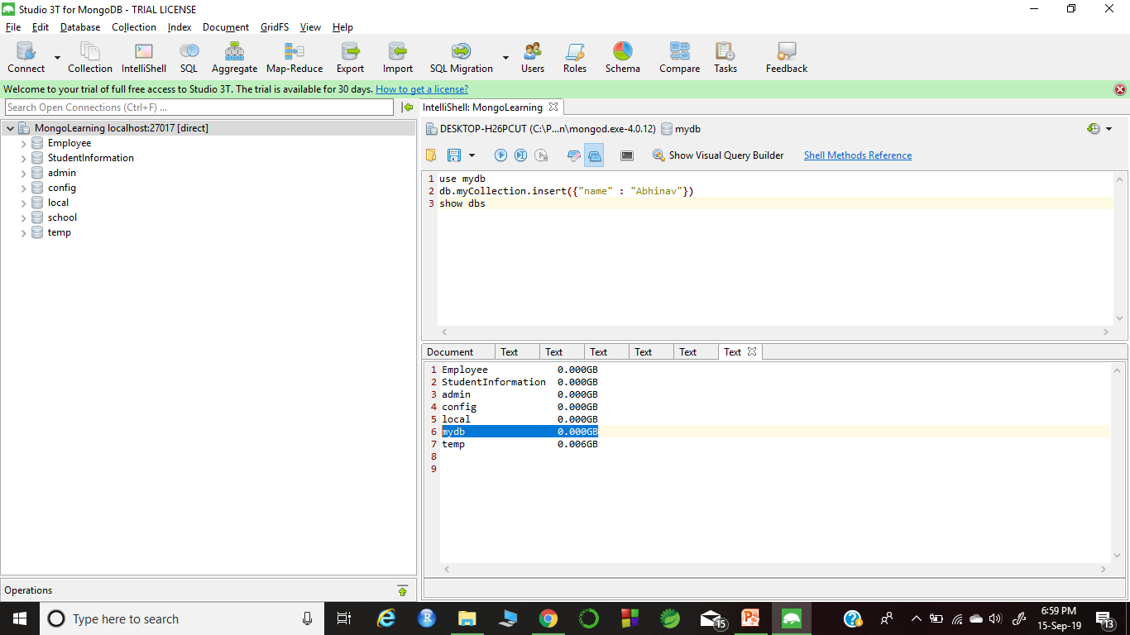
Continue…

Slide 14
Continue….
For dropping the database
Syntax : db.dropdatabase()
Output : -{
"dropped" : "mydb",
"ok" : 1.0
}
Note: - It will delete the current database
Then we use show dbs for confirmation

Slide 15
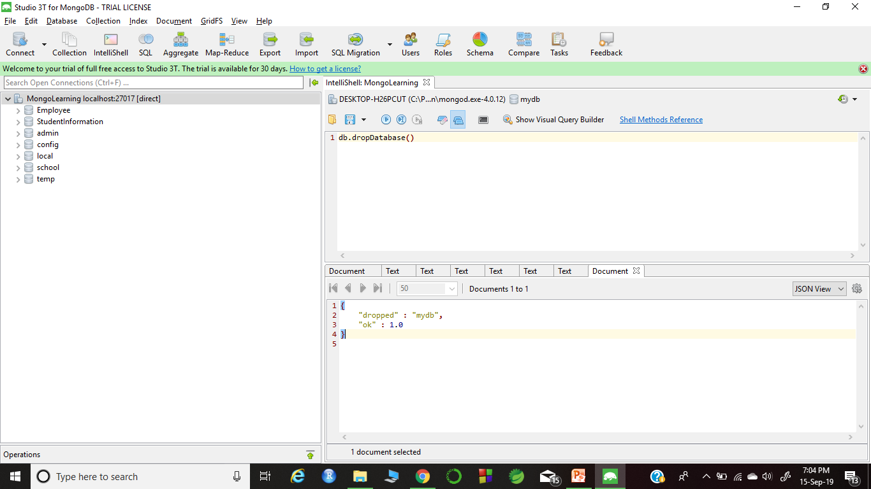
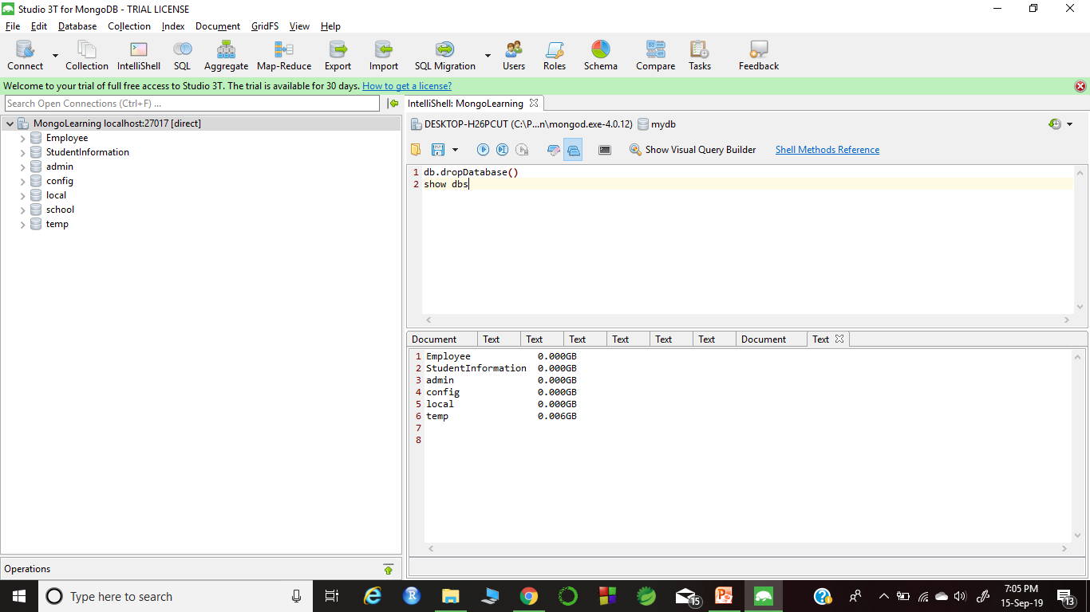
Continue….

Slide 16
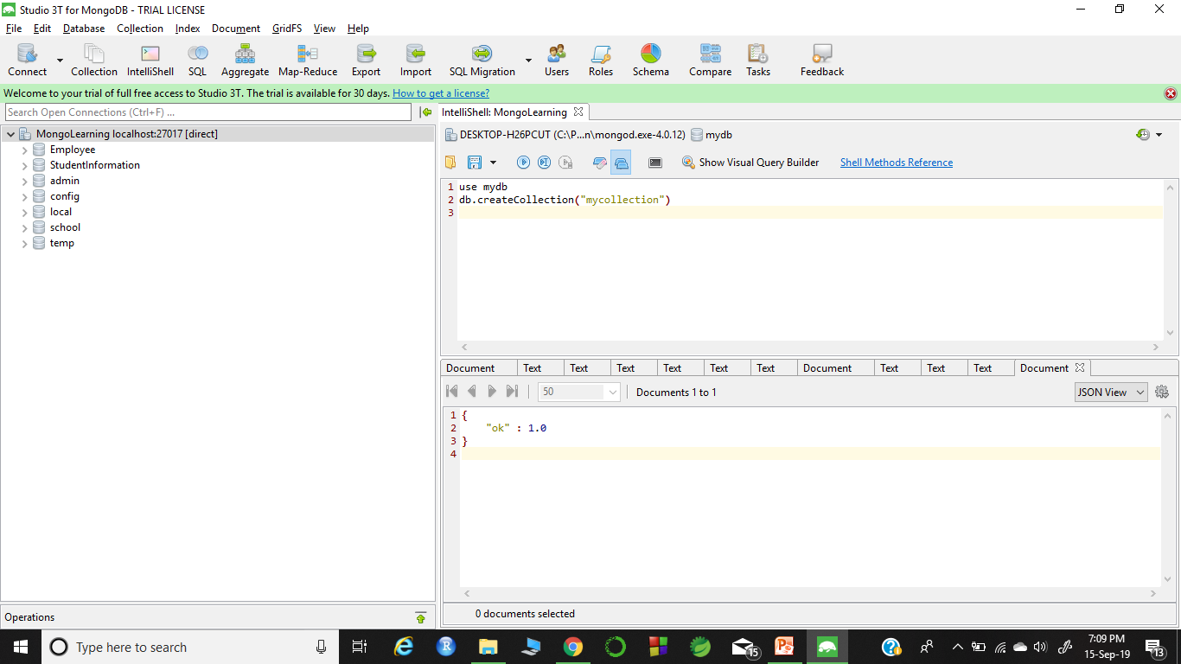
Create and Drop Collection
For creating the collection
Syntax : - use mydb
db.createCollection("mycollection")
Output : -
{
"ok" : 1.0
}

Slide 17
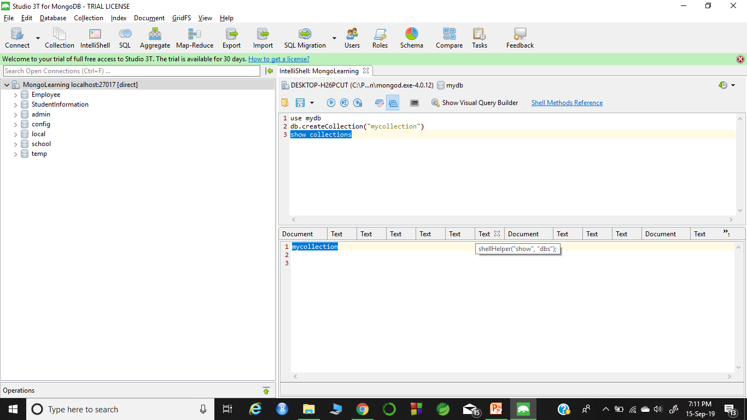
Continue…
For viewing the collection
Syntax: - show collections
Output : mycollection

Slide 18
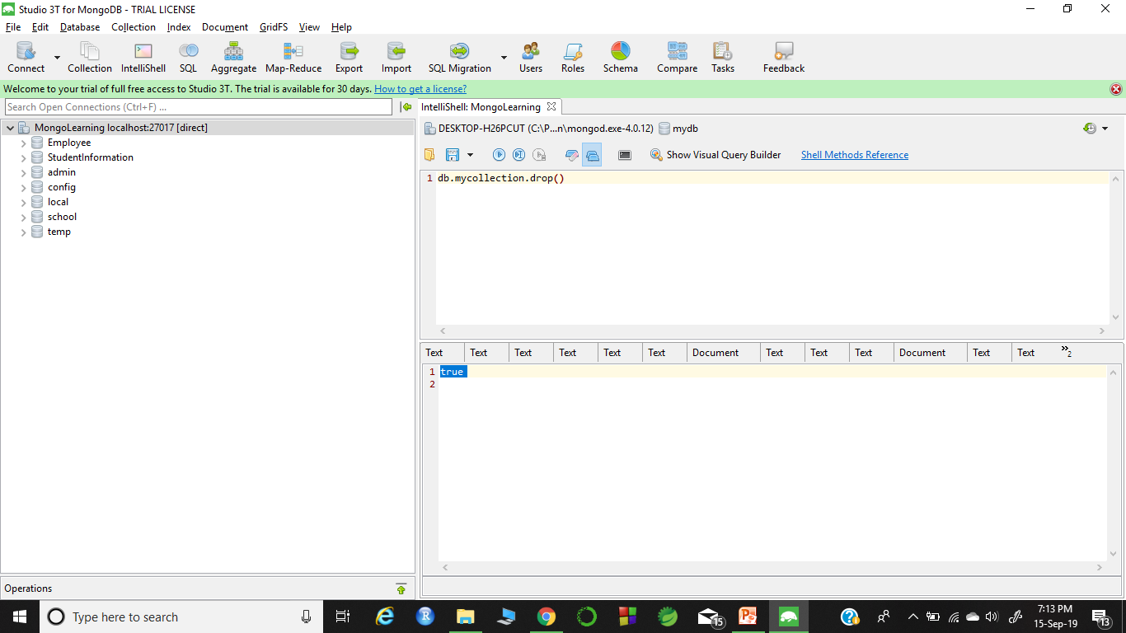
Continue…
For dropping the collection
Syntax : - db.<collection name>.drop()
Example : db.mycollection.drop()
Output: true
To check the collection, command is show collections

Slide 19
Insert Documents
Create database
Create collection for the database
Insert the n number of record by using array concept
Syntax for insert documents:
db.<collection name> .insert(
[{#Example { "StudentID":"1",
"StudentFirstName":"Abhinav",
"StudentSeconName":"Anil",
"Age":“23"
}, { "StudentID":"2",
"FirstName":"Abhishek",
"SeconName":"Ananad",
"Age":“24"
}}])

Slide 20
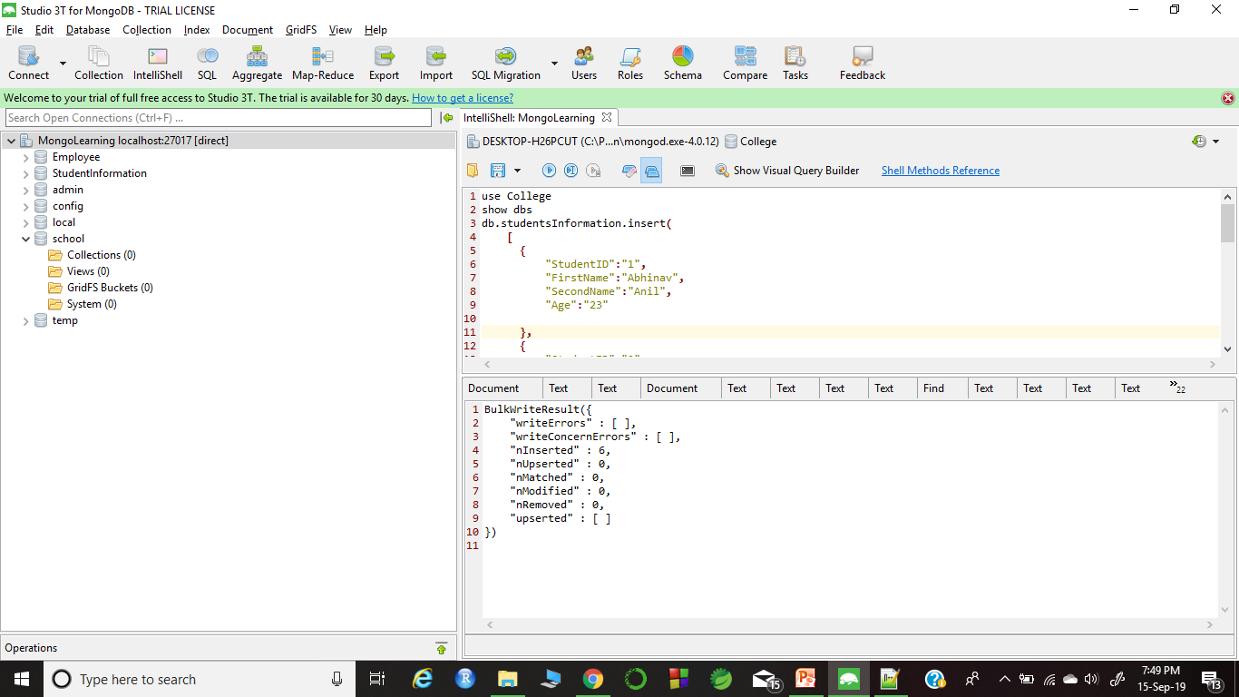
Continue

Slide 21
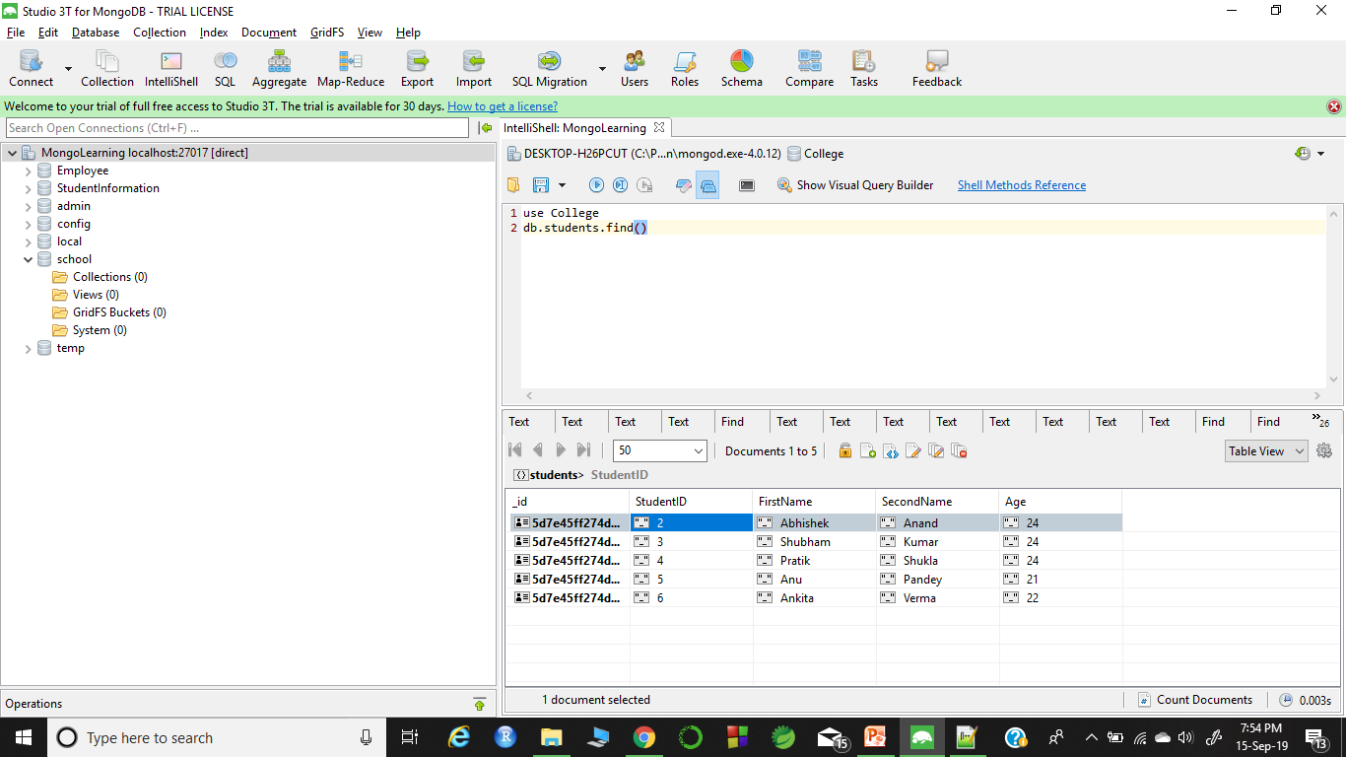
Query Documents
For fetching or viewing all the records that has been inserted
Command : find()
Syntax : db.<collection name>.find()
Examle: db.students.find()

Slide 22
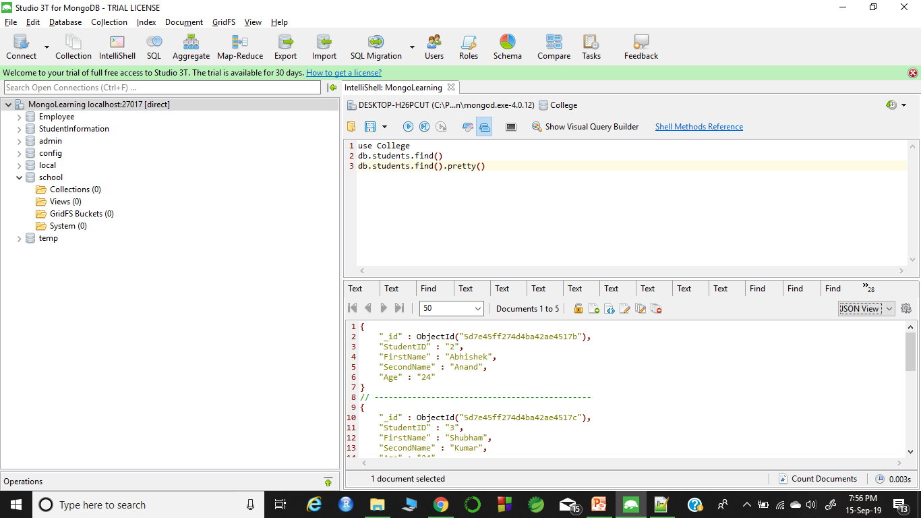
Continue…
We can also use pretty() command for more clear view

Slide 23
Continue…
Other command for searching are
findOne() #show the first record
Using condition like
db.students.find(
{
“Age” : {$gt : “21”}
}
)
Note: gt is for greater than
lt is for less than
Lte is less than equal to
Gte is for greater than equal to
Ne is for not not equal to

Slide 24
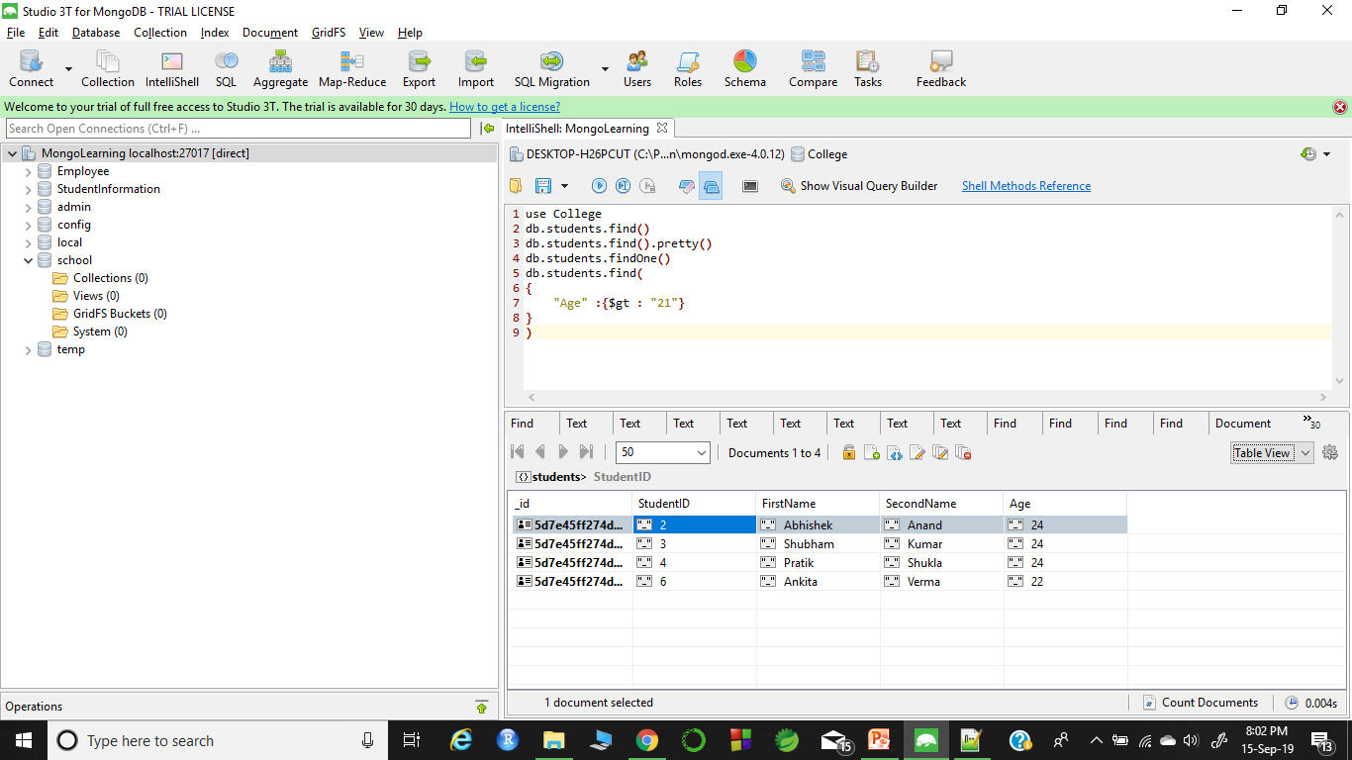
Continue…

Slide 25
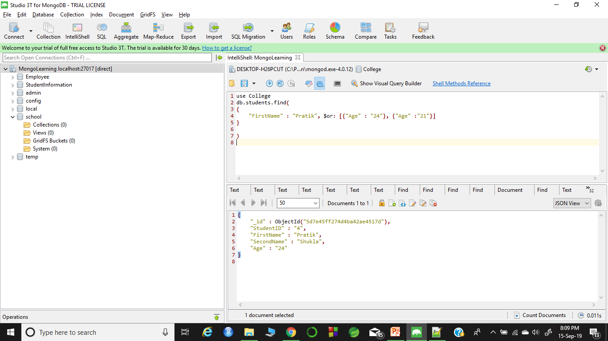
Using OR AND condition
Syntax for OR is $or
Syntax for AND is “,” follows by other conditon
Example :
db.students.find({
"FirstName" : "Pratik", $or: [{"Age" : "24"}, {"Age" :"21"}]
})

Slide 26
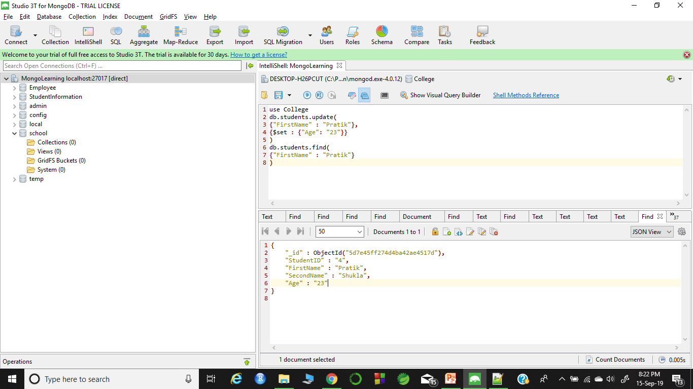
Update Documents
Synatx :db.<collection name>.update()
{$set: {“Key”: “Value”}}
Example : db.students.update(
{"FirstName" : "Pratik"},
{$set : {"Age": "23"}}
)
Note: If the records is having duplicate value and you want to that effect happens on both the record then use
{multi : true}

Slide 27
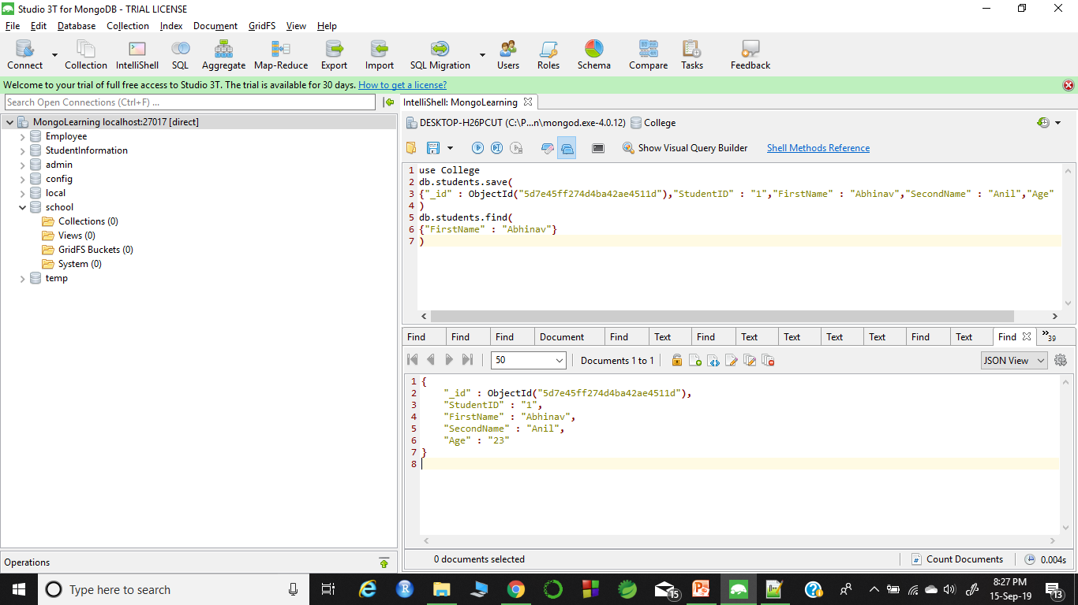
Save Command
It is been used to add and update record
Syntax: For adding db.<collection name>.save(
{key:value, key:value…..}
)
For Example: db.students.save({"_id" : ObjectId("5d7e45ff274d4ba42ae4511d"),"StudentID" : "1","FirstName" : "Abhinav","SecondName" : "Anil","Age" : "23"})

Slide 28
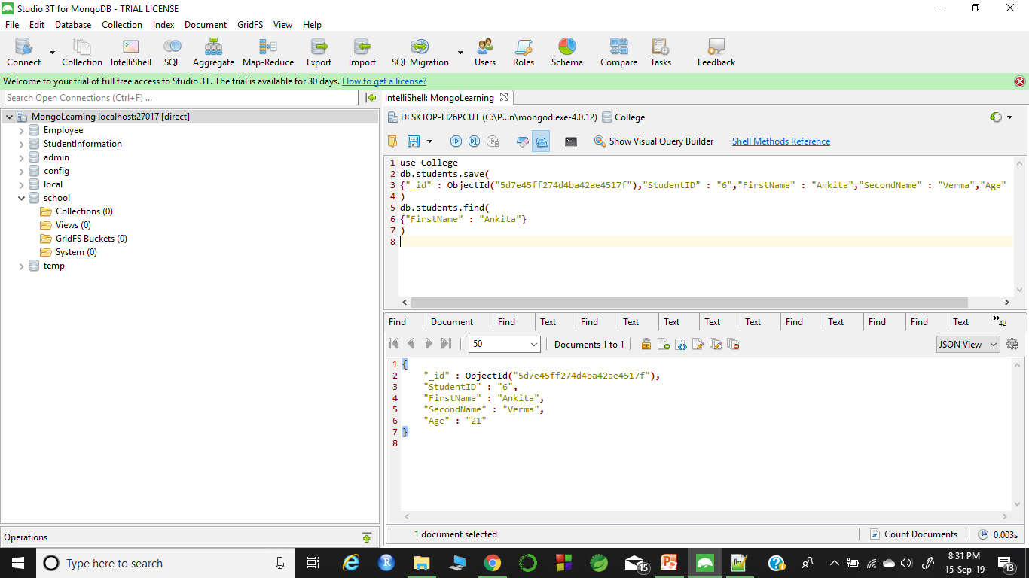
Continue….
For Updating
Syntax : db.<collection name>.save({“Key”: updated value})
For examle db.students.save({"_id" : ObjectId("5d7e45ff274d4ba42ae4517f"),"StudentID" : "6","FirstName" : "Ankita","SecondName" : "Verma","Age" : "21"})
# Age change from 22 to 21

Slide 29
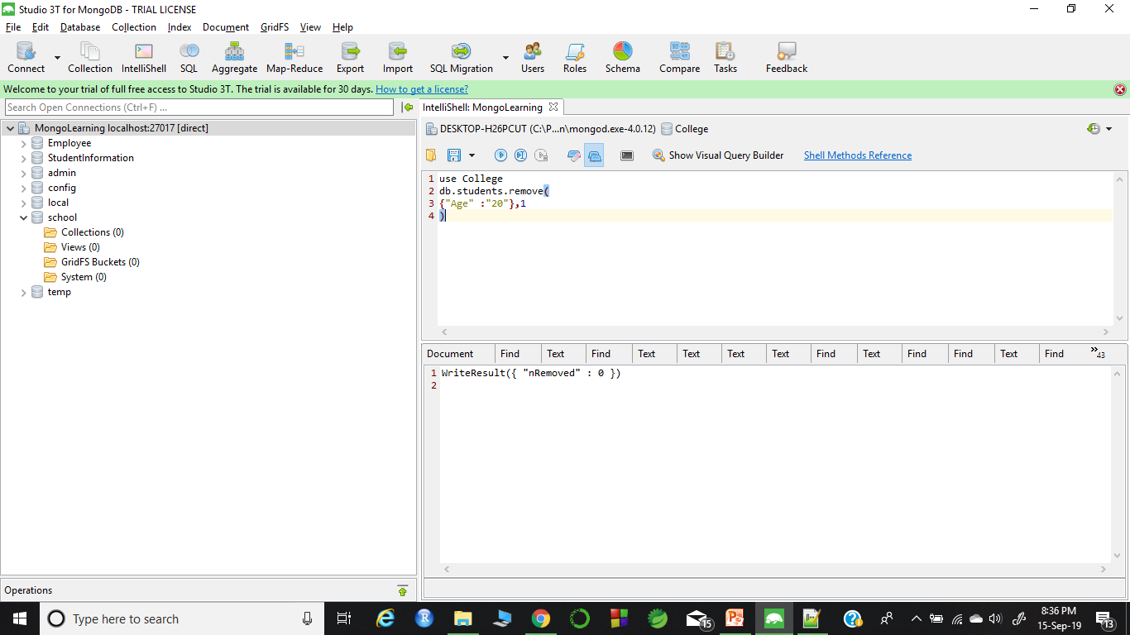
Delete document
Syntax : db.<collection name>.remove()
Example: db.students.remove({"Age" :"20"},1)
In my case none of having age 20

Slide 30
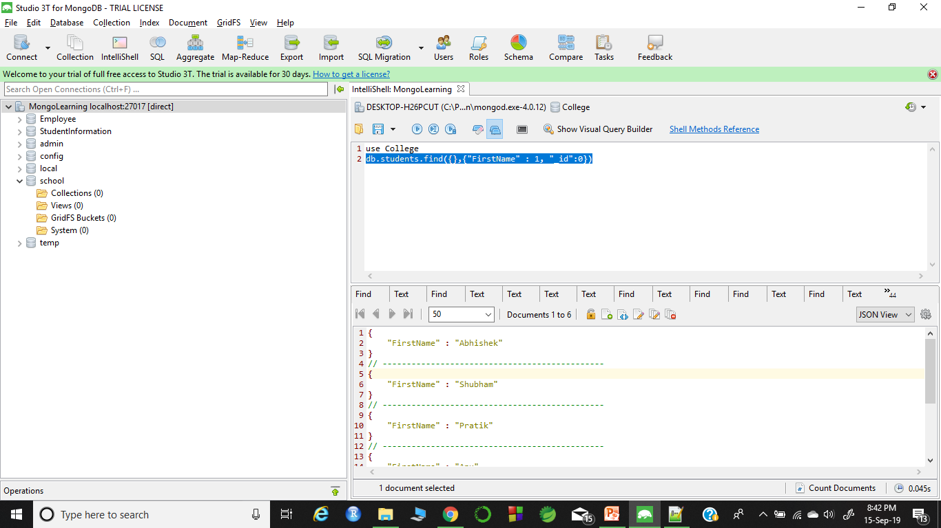
Projection
It means to select only the necessary data.
Syntax : db.<collection name>.find({},{KEY : 1})
Example : db.students.find({},{"FirstName" : 1, "_id":0})
Note 1 is for true and 0 is for false

Slide 31
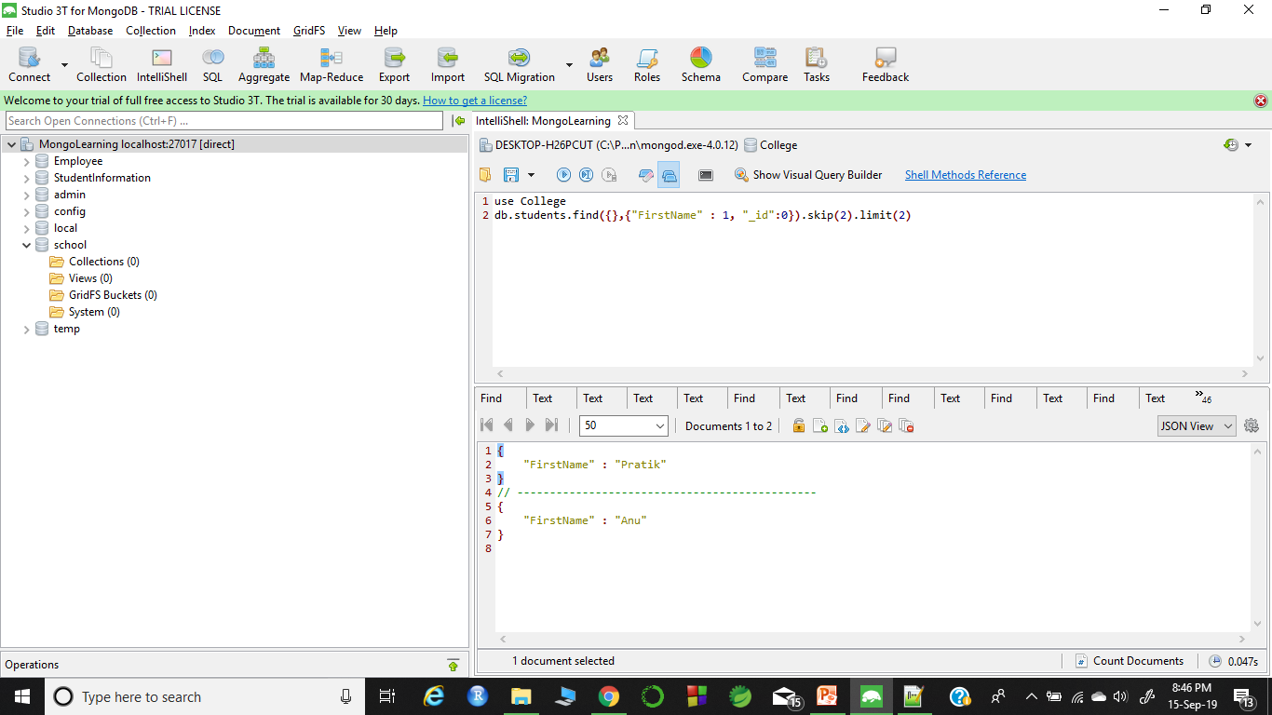
Using Sort, Skip and Limit
Command for limit is limit()
For skip is skip()
And, for sort is sort()
Example of limit and skip together
db.students.find({},{"FirstName" : 1, "_id":0}).skip(2).limit(2)

Slide 32
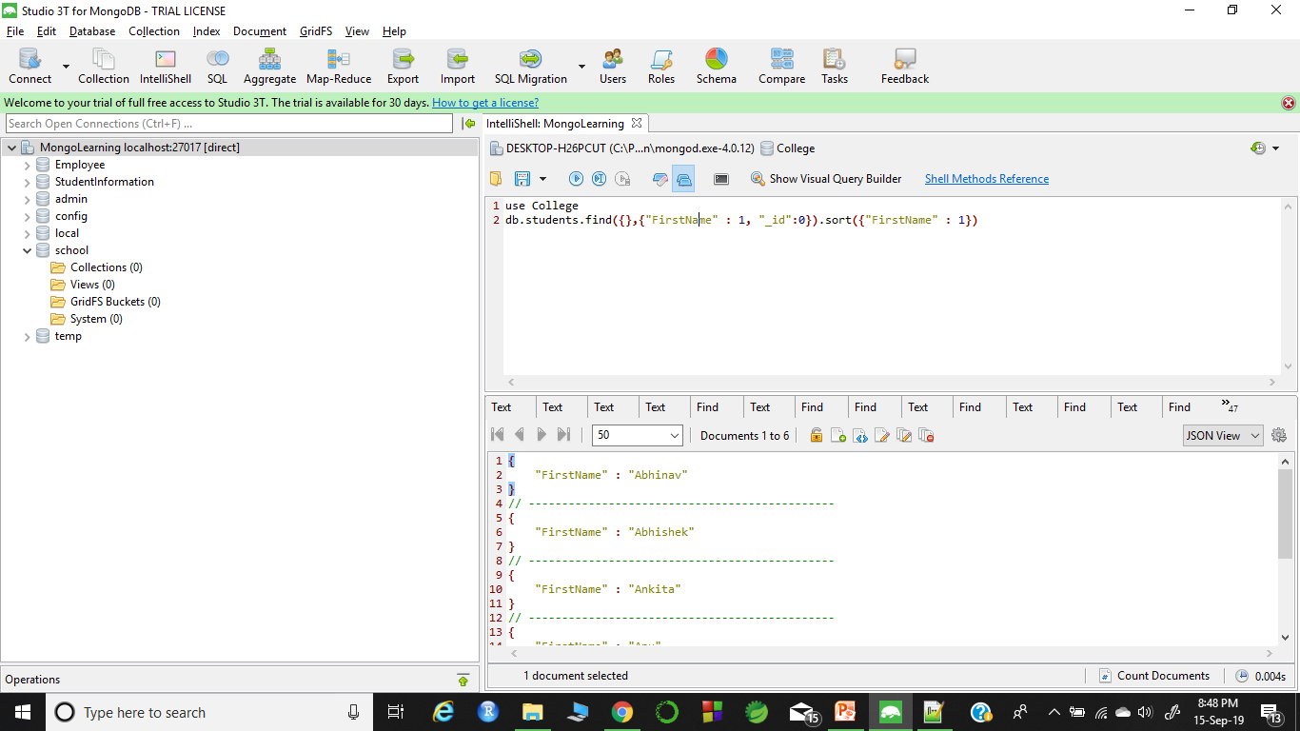
Continue
For sort :
db.students.find({},{"FirstName" :1,"_id":0}).sort({"FirstName" : 1})
Note : 1 for ascending order and -1 for descending order

Slide 33


